Slide 1

NHL Playoff Fantasy Players
C2C Jacob Lindell
C2C Joseph Haug

Slide 2
Background
Why we did this
Other ranking systems
Notes:
TheHockeyNews.com does a top 100 players, and Bleacherreport ranks top 20 players, but does not say how they decide the rankings
Both do one annually, but they are the only ones I have seen.

Slide 3
Process
Team Rankings
1
Team Stats
2
Sim
3
Sim 2.0
4
5
Player Stats

Slide 4
Step 1: Team Ratings
Min Sum of Squares
Average team rating= 85
Used later for random ratings

Slide 5
Step 2: Team Stats
Used for G/GP and GA/GP
Team Points are used later
Predicted P/Gm
Avg Games
Predicted Points

Slide 6
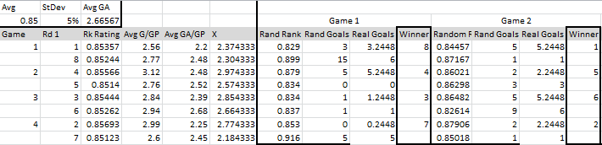
Step 3: Sim
X- Gives what the team is expected to score against their opponent
Random rating- Finds a random rating
Random Goals- Outputs an integer from a poisson dist.
Notes:
X= Found by subtracting the difference between Avg GA and opponent’s GA from team’s G/GP
Rand rating= based on the given team rating, the average team rating (0.85) and the standard dev. (.05)
use Norm.inv
Rand Goals= ranpoi(X,RR*rand)
Based on X and Random Rating

Slide 7
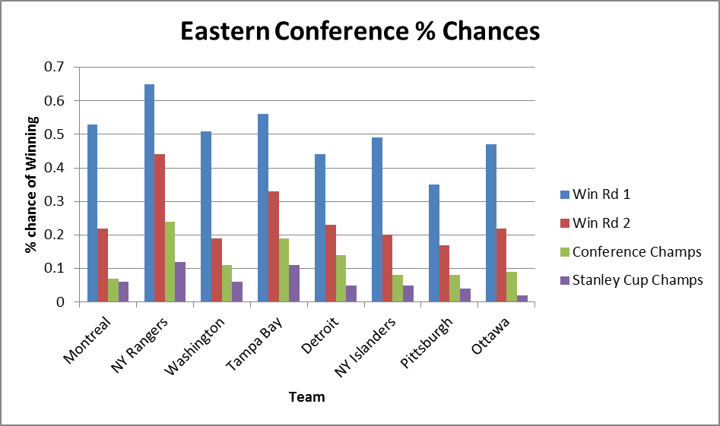

Slide 8
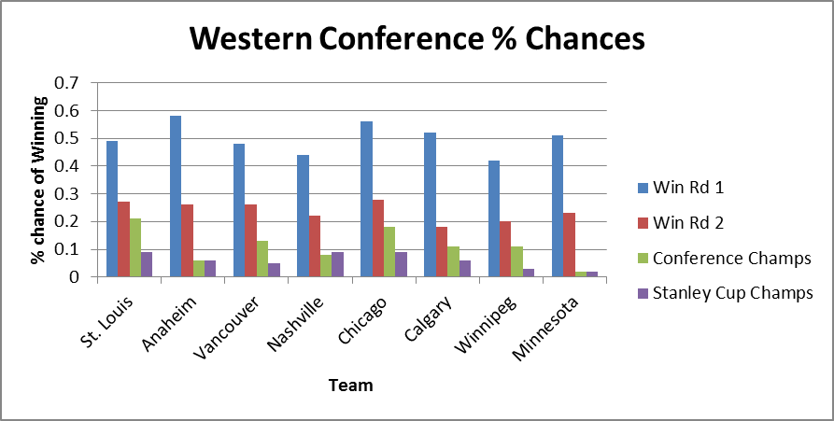
Notes:
Predicted all 8 games of first round correctly

Slide 9
Sim 2.0
Problem: All teams have an average of around 8 games
Solution: Solidify first round

Slide 10
Step 4: Player Stats
Projected Playoff Points
% of Team Points
Projected Average Games
Average Team P/G

Slide 11
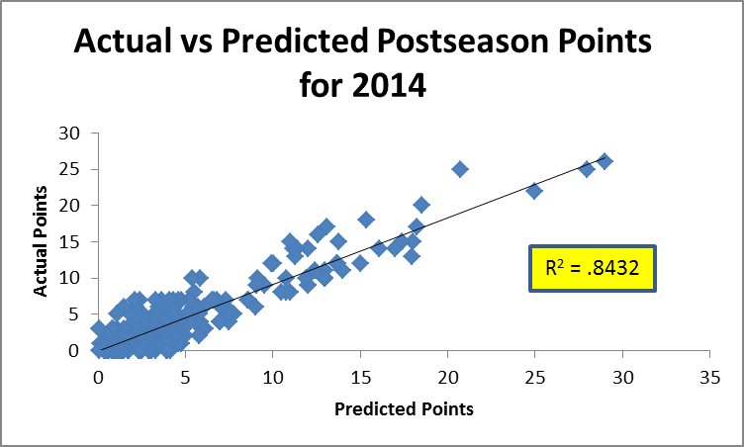
Last Year

Slide 12
Questions?

